Slide 1
Location Alarm Application Using Geo Location API Course No : CSE 3200 Course Title : System Development project
Supervised By
Dr. Pintu Chandra Shill
Professor,
Department of Computer Science And Engineering,
KUET
Presented By
Afnan –Ul-Haque
1607046
Faisal Ahmed
1607048

Slide 2
Scenario
Scenario 1:
Imagine you are travelling from campus to Dakbangla in KUET bus. You want to get off at new market but unfortunately you fall asleep in the bus and as a result when you woke up,
you see that you are in Dakbangla !!
Scenario 2:
Imagine you are going to a important place like class room , mosque, temple .
Unfortunately ,you forgot to silent of your phone and as a result your phone is ringing in those place .
Question :
How can you solve this two problem using a android app ?

Slide 3
Problem Statement
Following this two scenario ,we need
A notification when passing through the location with an alarm or a vibration .
Keep mobile silent in those important place like class room , mosque ,temple .
Know the exact position with highest precision of the user .
Know the position with offline and online mode .

Slide 4
Objectives
Get user real time locations .
Trigger an alarm with notification in the device on a specific desired location according to user defined range .
Turn device silent in designated locations .

Slide 5
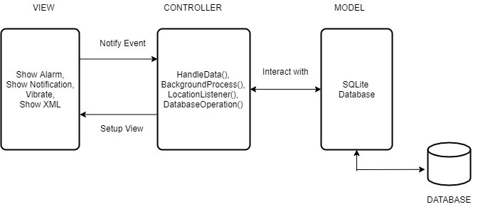
Design Pattern : MVC

Slide 6
Design Pattern : MVC
Model : SQLite database operation
View : Show notification ,alarm ,vibration and the XML files
Controller : HandleData() ,BackgroundProcess(), LocationListener(), DatabaseOperation()

Slide 7
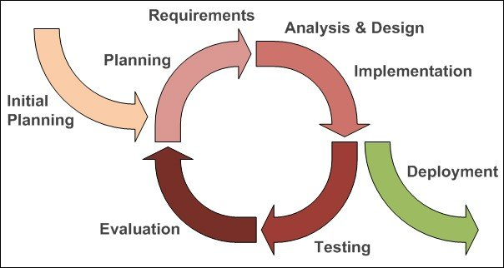
SDLC : Iterative Model

Slide 8
Technical Details
The application is developed in Android Studio in Java programming language.
In developing this application Geolocation API is used to get the user location and address of the location.
SQLite database is used to do the Model work for our project in MVC design pattern.
Job Scheduler Class is used to do the work of background processing that detect if any the device is inside any specified location.

Slide 9
Why use Geolocation API?
We have used Geolocation API because this API enables us to get the user location and its address very easily even in offline mode. The app has the permission of GPS provider and Network provider. This permissions allow us to get the users real time location even if we don’t have any kind of data or internet connection available. The Geolocation API returns a location and accuracy radius based on information about cell towers and WiFi nodes that the mobile client is connected to.

Slide 10
Why use SQLite?
Android comes in with built in SQLite database implementation.
As we want to make this app work in offline mode ,we have no other alternative to use SQLite database. Even for our background processing where we detect if we are inside any location or not , we can access this database and also update it according to our need. We have implemented Database helper class extending SQLiteOpenHelper class to do the database works.

Slide 11
Permission used for the app
Location permission.
Notification service permission.
Audio service permission.
Internet permission.
Wake lock permission.

Slide 12
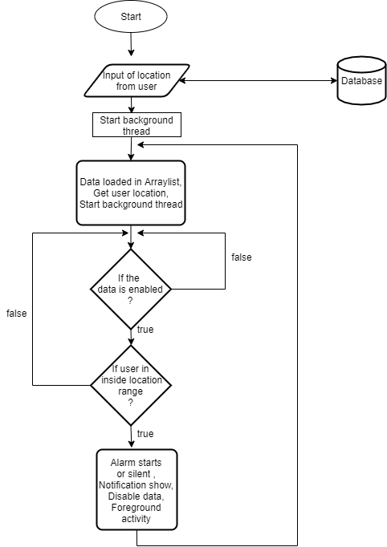
Functional Diagram

Slide 13
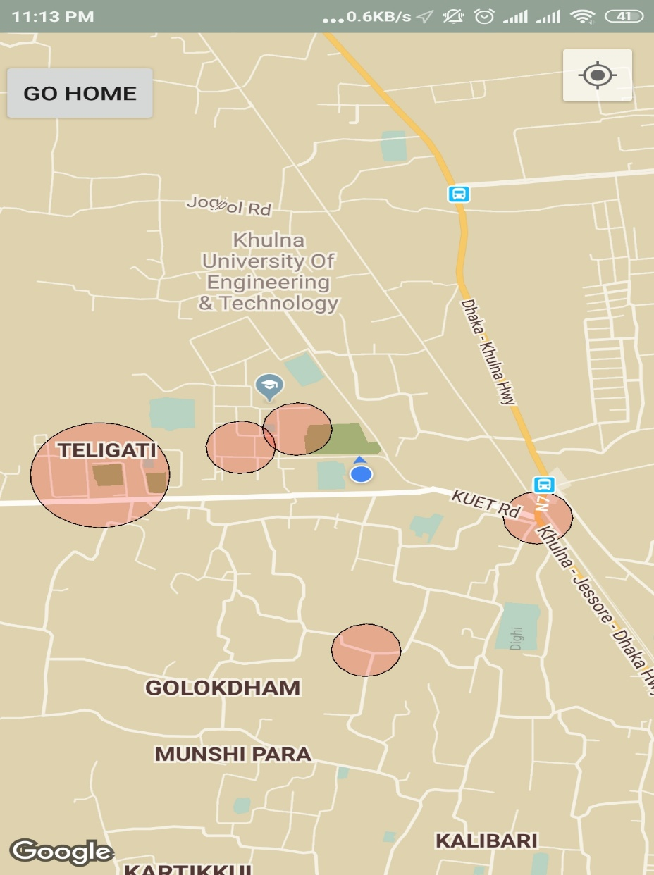
Overview
When the user opens the app, it shows the map view with the users enabled locations saved locations with range the user specified.

Slide 14
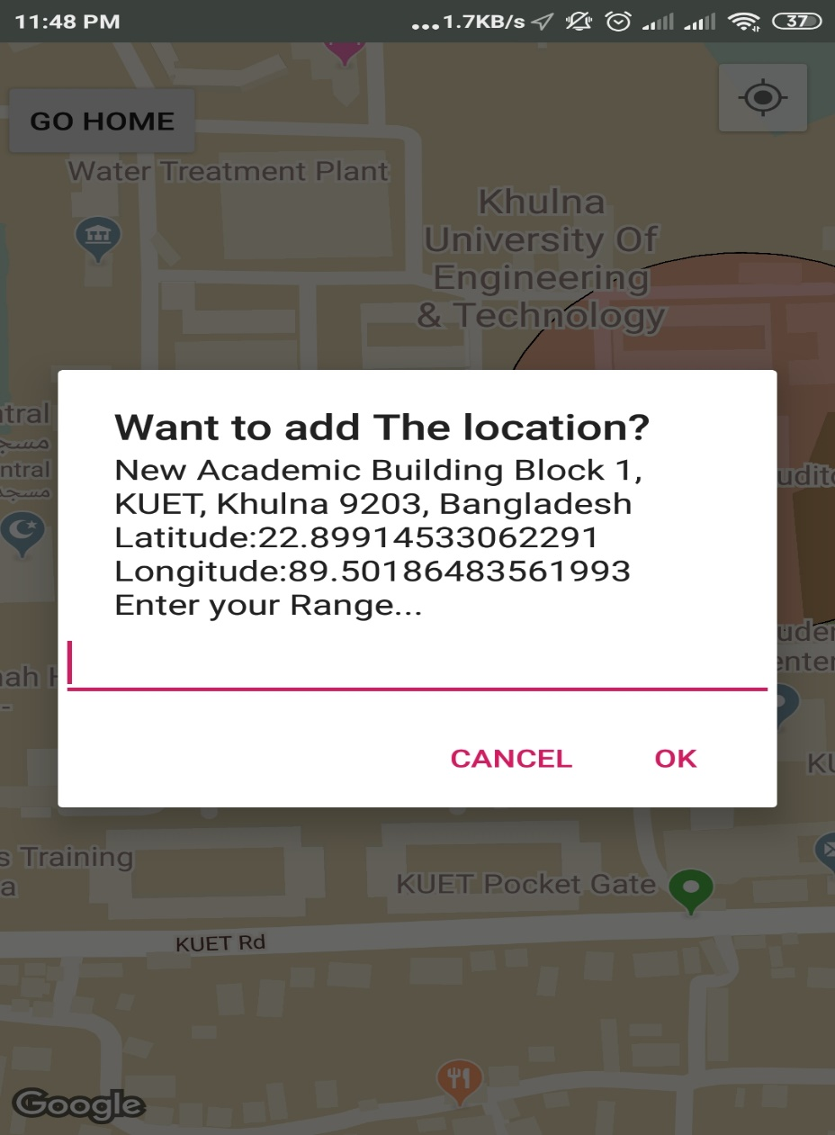
Overview…
When touching on the map, a pop up interface appears where the user can add the location with specified range the user wants. Pressing OK the location will be saved for alarm/silent feature.

Slide 15
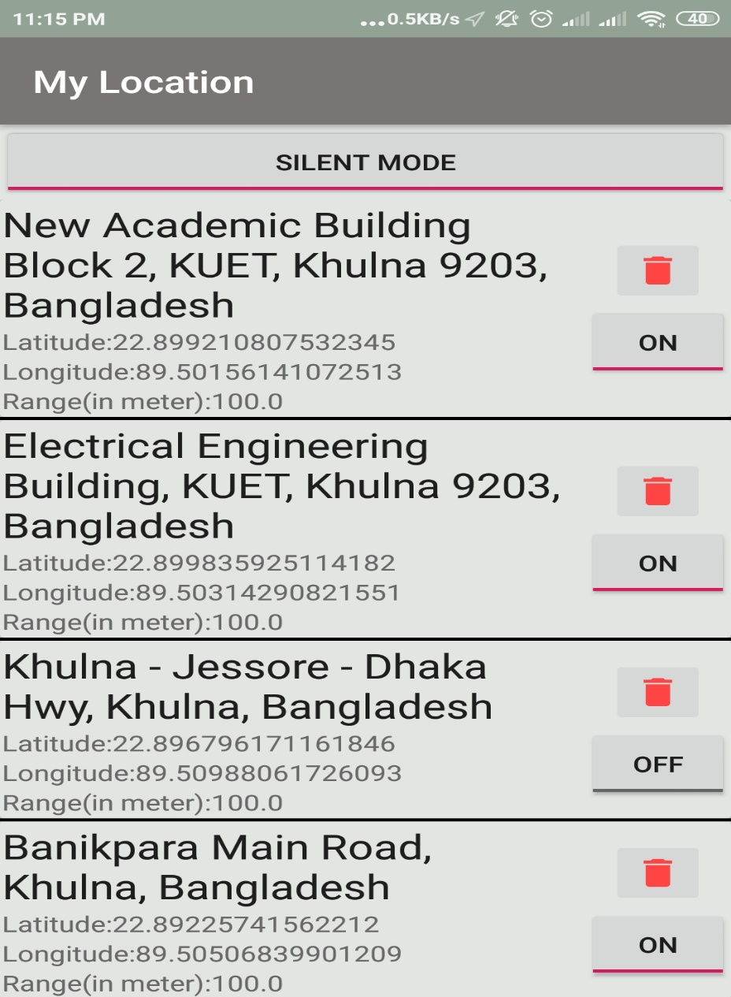
Overview…
By pressing GO HOME button, the user can see the added locations in list view. Here user can decide which location to be enabled and also choose if user wants silent mode or alarm mode.

Slide 16
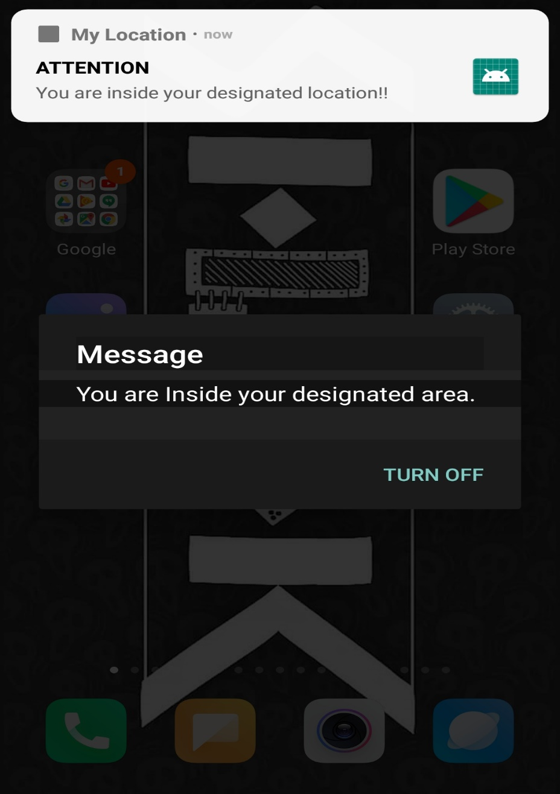
Overview…
When the user is inside any of the locations enabled, application will show a notification and trigger an alarm with alarm tone.

Slide 17
Challenges faced
In developing the app, we at first faced the problem of getting real time location irrespective of any data connection.
We had problems to implement our background process working in Job Scheduler Class.
We had to check a lot off cases and handle exceptions. It was very hard to find out all the bugs as this exceptions always crashed to compile.
It was a problem to show notification, trigger alarm and silent the
device when the phone is locked and screen turned off.

Slide 18
Future Development
We have plans to upload this application to Google Play Store.
Before uploading this application, we want to make an snooze option for alarm.
We also want to make the UI of this application more user friendly that the user can feel free.
Background process will be made more efficient.

Slide 19
Conclusion
The Location Alarm application is developed using Android Studio fully meets the objectives of the system which it has been developed. The system has reached a steady state where all bugs have been eliminated. The system is operated at a high level of efficiency and all the user associated with the system understands its advantage. The system solves the problem. It was intended to solve as requirement specification

Slide 20
ACKNOWLEDGEMENT
We would like to express our profound and sincere gratitude to our project supervisor Dr. Pintu Chandra Shill, Professor of Department of Computer Science and Engineering, Khulna University of Engineering and Technology, Khulna for his rationale guideline, encouragement and for taking time off his busy schedule to provide invaluable input to words to complete our project. His suggestion and encouragement play a vital role in our project work.

